Slide 1
Web Design
Fundamentals of Web Design - slide 2
The Making of a Good Design - slides 3-4
Typical Web Site Evolution - slide 5
The Process of Web Design - slides 6-9
Pre-design Work - slides 10-11
Influences on Design - slides 12-24
  Technology, Content, Economy, Visuals, Usability, Conventions
Accessibility Issues - slides 25-26
Maintenance/Improvement - slides 27-28
Resources - slides 29-30
Notes:
After discussing what we’ll be talking about today, on 2 screens, show examples of both good design and bad design.
Bad design=show webpagesthatsuck.com, http://www.webpagesthatsuck.com/wpts1/, http://www.ty.com, http://www.cuttingedgebankcard.com/, http://www.daltonmailingservice.com/
Good design = show coolhomepages.com, kinkos, gap, disney, https://itss.stanford.edu/organization/clientsupport/dtl/training/who.html
http://coursework.stanford.edu

Slide 2
Fundamentals of Web Design
Purpose of Web Design
  Inform/Educate
  Persuade
Influences on Web Design
  Technology Used by Both Target Audience and Designer
  Nature of the Content
  Economy (Budget, Time, and Scale of the Project)
  Amount and Type of Visuals Included
  Meeting Usability Objectives

Slide 3
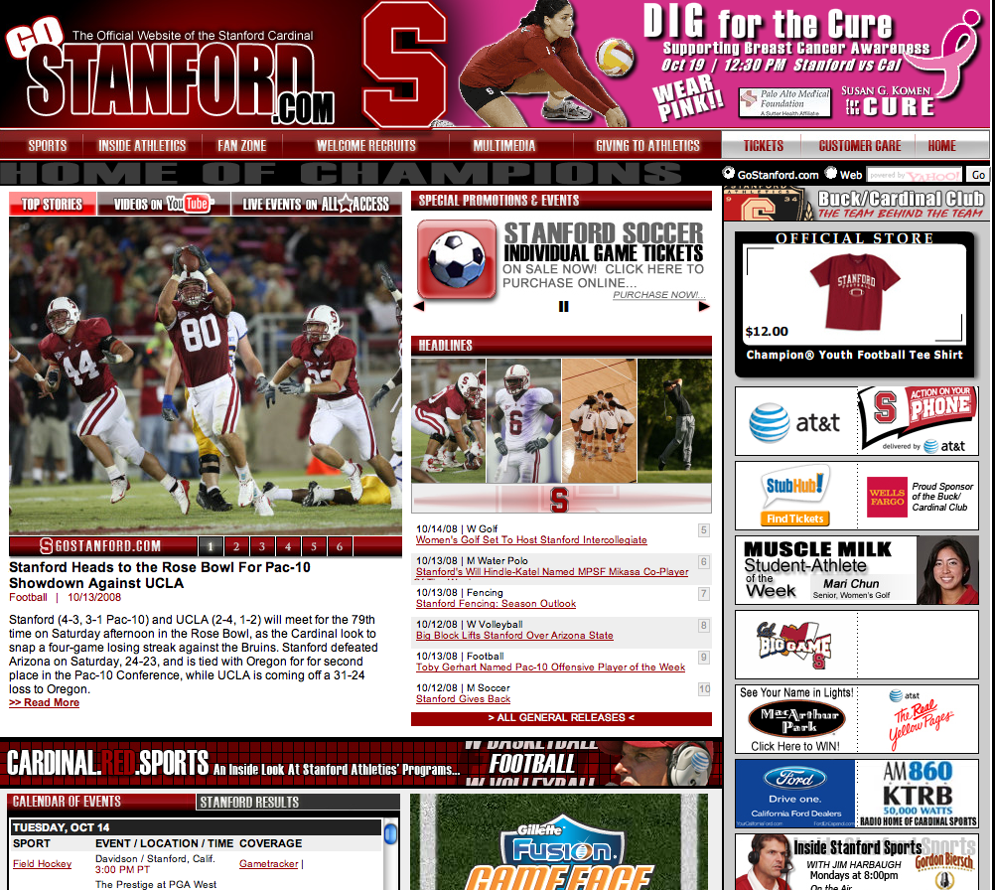
The Making of a Good Design
Content is important, but content alone will not make your site work.
Notes:
Biggest mistake in web design is to build a site for the designer, not the user.
Users expect sites to be flawless.
Looks matter. Site should be pleasing to the eye. Site should evoke trust and value.

Slide 4
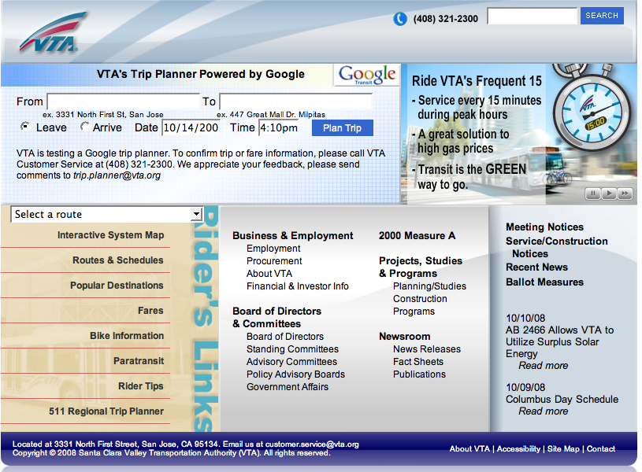
The Making of a Good Design
Content is important, but content alone will not make your site work.
Good Design is:
  Understandable
  Interesting
  Easy to use
  Uniform in look and feel
  Done from a visitor’s point of view:
    WYSIWYW (What You See Is What You WANT)
Notes:
Biggest mistake in web design is to build a site for the designer, not the user.
Users expect sites to be flawless.
Looks matter. Site should be pleasing to the eye. Site should evoke trust and value.

Slide 5
Good Design Maxims
“Rules” are only guidelines -- no single model fits every situation, and there is no such thing as the “right” way to create a web site.
Remember WYSIWYW
  Web users want control over the online material -- they want to seamlessly obtain the information they need.
  Don’t force visitors down a specific path -- give them control.

Slide 6
Typical Website Evolution
Generation 1 -- replaces paper information
Generation 2 -- has flashy elements
Generation 3 -- is bleeding edge, causing content to suffer
Generation 4 -- content and technology are integrated
Ideally, try to skip the problems of
Generations 1-3 by planning your web site
carefully.

Slide 7


General Methods for Design
“Ad-hoc” Process (“seat of the pants”)
  Hastily put together
  Created on the fly
  “We need a web site TODAY”
A methodical, well-thought process includes:
  Planning
  Quality-assurance testing

Slide 8
Pitfalls of Ad-hoc Process
Many “under construction” banners
Old content
Dated design and techniques
Errors (broken links, broken scripts)
Convoluted logic results in a confusing site
“Spaghetti code” in the CSS that only the original designer understands
Difficult to update and maintain

Slide 9
Benefits of Ad-hoc Process
Sometimes “quick and dirty” is not only good enough, it’s the best way.
It’s useable for:
  Sites that will have a short lifespan
  Very small web sites
  Sites designed for a very specific purpose (a single survey, a single class, a specific event, etc.)

Slide 10
Why take the time to design and test before launching?
Although it takes a lot more time up front, a well-thought-out web site:
  Has fewer problems
  Is more effective
  Is more understandable
  Is easier to navigate
and may end up taking less time overall to create and maintain.

Slide 11
Pre-design Work
Consider your organization’s mission
Define the target audience
Set goals for the web site
  Immediate
  Long-term
Gather content
  Organize and establish hierarchy of content
  “Chunk” content into logical information units
Notes:
Start by looking at the big picture, then work down to the specifics.
1) define the problem/goal for the site
2) analyze the requirements
3) design a prototype; implement and test the site
4) show to clients; get feedback
5) develop new prototype
6) release and maintain the site
Forces developers to plan everything up front

Slide 12
More Pre-design Work
Create an outline or plan for content
Create your web site on paper first
  Use a flowchart to depict how visitors will go from one page to another
Think about the actual HTML, PDF, graphic, sound, and other files you will need in the site
  Where will they be placed?
  How will visitors access them?
Organize the files logically, so that the development team can understand the hierarchy of the web pages.
Notes:
Site plan:
Goal statement
Audience assessment
Content requirements
Technical requirements
Visual requirements
Delivery requirements
Site structure diagram
Staffing requirements
Timeline for project
Budget estimate

Slide 13
Influences of Technology on Design
Browsers
  Internet Explorer is the dominant browser
    <http://www.w3schools.com/browsers/browsers_stats.asp>
    <http://www.e-janco.com/browser.htm>
Operating systems
  Windows XP is the most popular operating system
Connection speeds
  75% access the Internet using broadband (DSL/T1/T3)
  25% access it using narrowband (modem)
    <http://www.websiteoptimization.com/bw/0609/>
User screen sizes
  80% of users are using a display with 1024x768 pixels or more and a color depth of at least 65000 colors
    <http://www.w3schools.com/browsers/browsers_stats.asp>

Slide 14
Influences of Content on Design
The content drives how the web site looks
    Sites designed for students look different than sites designed for staff, which look different from sites designed for potential faculty
    Sites designed for current employees look different than sites designed for potential clients
    Sites designed to get people to purchase items look different than sites designed to provide information
Use quality content from subject matter experts
Have site reviewed PERIODICALLY by key members (CEOs, Department Heads, Supervisors, etc.) of the group the site supports
Have non-affiliated people review content for clarity
Have others proofread for grammar
  Fresh eyes often see things you miss!
Notes:
Make sketches on paper or screen to begin with
- allows for creativity without limitations of HTML
- think about how it’ll look in a web browser
Create template web pages instead of real content during design phase
- reduce mockup time
- easier to make changes quickly

Slide 15
Economic Considerations
Budget concerns
  Staff time for creation
  Staff time for maintenance
  In-house vs. outsourcing

Slide 16
Usability
Browsers don’t use web sites -- people do. Don’t design a site for a particular browser -- design a site for the user.
There are no generic people. Try to envision a real person accessing your site.
  Most users absorb data visually.
  Most users will not expend effort to remember things about how your site works.
Notes:
Remember, most users will not have really fast machines with lots of memory and disk space. Most users will not have as good a machine as a developer! Don’t develop web pages for you – develop them for your users!

Slide 17
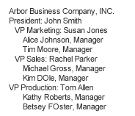
Visual items
Compare:

Slide 18
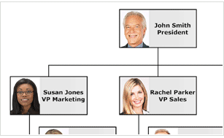
Visual items
Compare:

Slide 19
Usability -- Making It Easy To Read
Factors that affect readability
  Poor eyesight of users
  Smaller, older computer monitors as displays
  Poor color perception of users
  “Cocktail-party” effect -- lots of information on a single web page
Design fixes:
  Use high contrast between text and background
  Use lots of white space
  Use larger fonts
  Put key navigation buttons in the upper left
  Don’t rely on color alone to distinguish between elements on a web page
  Avoid busy graphics
  Limit page noise -- ensure page elements don’t compete for a visitor’s attention
Notes:
Upwards of 20% of all men are color blind. Always use something other than color to distinguish elements on a web page.

Slide 20
Usability -- User’s Memory
Don’t force visitors to remember how to navigate/use the site
Provide redundant, easily recognizable features
Generally, have visited and unvisited links be different colors to make it easy for users to remember where they’ve been
Limit the number of items in a group of choices

Slide 21
Usability -- Response Times
The amount of time a user will wait is proportional to the payoff. If they know there is something they want to see, they will wait for it.
Otherwise…
  1 second: no major potential for interrupt
  10 seconds: users become bored
  More than 10 seconds: user may leave
  Without a progress bar or other browser feedback, users generally will go about other business -- look at sites in other windows, talk on the phone, etc. Designers must provide some sort of indication as to how much longer the download will take, if the wait will be more than 10 seconds.

Slide 22
Using Cutting-Edge Tools
Poor reasons:
  To look cool
  To prove you can
Good reasons:
  To look cool!
  To draw attention
  To maintain attention
  To enhance information
  To inform or educate

Slide 23
Accessibility Issues
Section 508 of the 1986 Federal Rehabilitation Act requires that entities doing business with the federal government must include solutions for employees with disabilities when awarding contract proposals.
The 1992 American with Disabilities Act states that firms with 15 or more employees must provide reasonable accommodation for employees with disabilities.
(see next slide for accessibility examples and fixes)
Notes:
activities and resources located in physical spaces are now becoming more online.
accessible webpages are more compatible with emerging technologies (PDAs, etc.)
physically accessible - user can get info
functionally accessible - user can make use of the info for intended purpose
good design: coursework.stanford.edu
use opera to show various views (emulate text browser)

Slide 24
Accessibility in Web Design
Make the navigation clear and simple
Use a clean visual layout with ample white space
Use descriptive link texts (avoid using “click here” without more information)
Provide text equivalents for non-text elements
Don’t rely solely on color to indicate links
Don’t make the screen flicker
Use plain, understandable English
Don’t rely completely on high-tech solutions
Use markup and style sheets -- HTML for structure and CSS for presentation. Don’t use visual markup (for example, to make text bold, use strong instead of b; to italicize, use em instead of i)
Don’t use header tags for visual formatting
Add "skip to" links to main navigation and page content
If PDF files are used, provide alternate formats for the information
Notes:
Best practices:
1) navigation is clear and consistent
2) clean visual layout & use of white space
3) CSS for visual formatting
4) Alt attributes for images
5) Header tags in their proper hierarchy (not for visual formatting)
6) flexible screen & font sizes
7) descriptive link text (not click here)
8) structural, not visual markup (strong not bold; em not i)
9) summary sentence at the top of each page
10) "skip to" links to main navigation and page content
11) PDFs - provide alternate formats
12) Audio/video - provide link to transcript

Slide 25
Approvals/Proofing (again!)
Get feedback on the entire web design from:
  Other web designers (for design)
  Subject matter experts (for content)
  All represented parties, including department heads, managers, deans, etc. (for final approval)
  Non-affiliated people (for clarity)
Proofread for grammar -- fresh eyes may catch things you miss!
Validate for accessibility and compliance with W3C guidelines
  http://wave.webaim.org/
  http://validator.w3.org/
  http://cynthiasays.com/

Slide 26
Maintenance/Improvement
Set a maintenance schedule for the site.
  Who will do the maintenance?
  What to do if emergency problems occur?
  Where will backup copies of the site be located?
Schedule a quarterly review of the site.
  Does the content need updating?
  Is the design still working?
  Are there newer, cutting-edge tools we should be using?

Slide 27
Resources - Web Sites
Web Style Guide
A thorough and accessible guide to Web design
http://www.webstyleguide.com/
Jacob Nielsen’s Use It
A web site devoted to accessibility issues
http://www.useit.com/
Cool HomePages.com
A listing of the “coolest” home pages
http://www.coolhomepages.com/
Vincent Flander’s Web Pages That Suck
Learn good design by looking at poorly designed web sites
http://www.webpagesthatsuck.com/
disABILITY Information and Resources
A listing of web sites to help make web pages more accessible
http://www.makoa.org/
Web Site Optimization Analyzer
Analyze time it takes for web site to load
http://www.websiteoptimization.com/services/analyze/
Web Browser Statistics
http://www.w3schools.com/browsers/browserstats.asp
Lynx Viewer
Emulations of lynx (text web browser)
http://www.delorie.com/web/lynxview.html
http://www.yellowpipe.com/yis/tools/lynx/lynx_viewer.php
WebTV Viewer
An emulation of the WebTV browser
http://developer.msntv.com/Tools/WebTVVwr.asp
HTML Validator
Validates HTML code
http://validator.w3.org/
Bobby Accessibility Validator
Validates web sites for accessibility issues
http://bobby.watchfire.com/
August 2005 Connection Speed Statistics: http://www.websiteoptimization.com/bw/0508/
World Wide Web Consortium
The organization responsible for creating official web standards
http://www.w3c.org/
W3Schools
Online web tutorials (also contains web statistics)
http://www.w3schools.com/

Slide 28
Resources - Books
  HTML & XHTML: The Complete Reference
    Author: Thomas Powell
    ISBN: 0-07-222942-X
  Web Design: The Complete Reference
    Author: Thomas Powell
    ISBN: 0-07-222442-8
  Designing With Web Standards
    Author: Jeffrey Zeldman
    ISBN: 0-73-571201-8
  HTML for the World Wide Web
    Author: Elizabeth Castro
    ISBN: 0-32-113007-3
  Integrated Web Design
    Author: Molly Holzschlag
    ISBN: 0-73-571233-6

